Slide 1
Healthy Relationships, Happy Connections

Slide 2
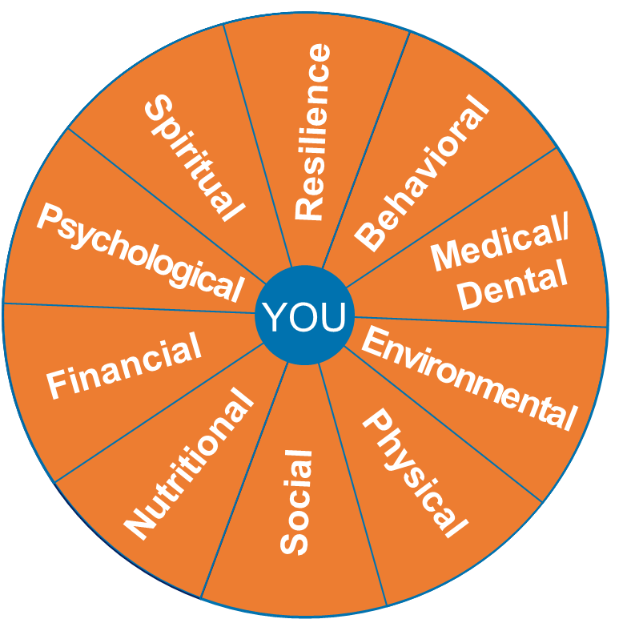
Total Force Wellness
Wellness Wheel + the 10 Different Facets
Psychological
Spiritual
Resilience
Behavioral
Medical & Dental
Environmental
Physical
Social
Nutritional
Financial
Physical & Sleep
Mental & Emotional
Relational & Social
Spiritual & Religious
Financial

Slide 3
Agenda
Discussion: What is a healthy relationship?
Relationship continuum
Barriers
Resources

Slide 4
Discussion: What does a healthy relationship look like to you?

Slide 5
Relationship Continuum

Slide 6
Boundaries: A structure for a Healthy Connection

Slide 7
Relationships Can Be Hard
Notes:
Discuss trauma/life experiences, relate to that grey unhealthy area.

Slide 8
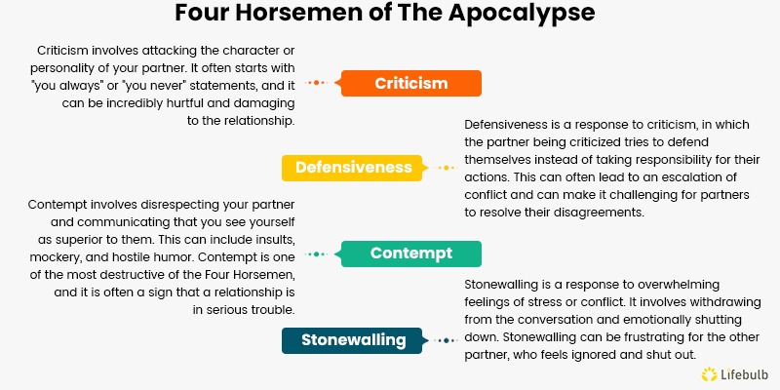
The Four Horseman of the Apocalypse

Slide 9
Repair: Healing Connections
Regret
Empathy
Intent to Change

Slide 10
When the Unhealthy Behavior Doesn’t Change
SAPR/VA
FAP
CGSUPRT
Telemynd

Slide 11
Contact Information
Nicole Pingel
Email: nicole.m.pingel@uscg.mil
Phone: 617-850-2704

